Slide 1
Bcace 136-e1: Internet basics and html
Mr. trivarna
Asst. Professor
Dr.B.B hedge college kundapura

Slide 2
internet
The word Internet is derived from two words interconnections and networks. Internet is a world wide system of computer networks, i.e. a network of networks, which allows the user to share information.

Slide 3
Basic internet terms
WWW:
The world wide web is a collection of linked documents or pages, stored on millions of computers and distributed across the world.
Web page:
The hypertext document in www is known as web page.
Website:
A website is asset of related web pages published by an organization or an individual.

Slide 4
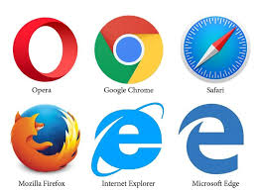
Home Page:
A home page is the starting point or a doorway to the website.
Browser:
A browser is special software that enables users to read or view web pages and jump from one page to another.
Browsers are of two types:
1. Graphical Browser
2. Text Browser
URL(Uniform Resource Locator):
Each web page has a unique address called a URL which identifies its location on the Internet.

Slide 5
Usually the format of an URL consists of 4 parts: protocol, name of the Web server(or domain name),path and filename.
Here is an example http://www.xyz.com/tutor/start/main.htm
The structure of this URL is:
Protocol: http
Web server name/domain name: www.xyz.com
Path: tutor/start
File Name: main.htm

Slide 6
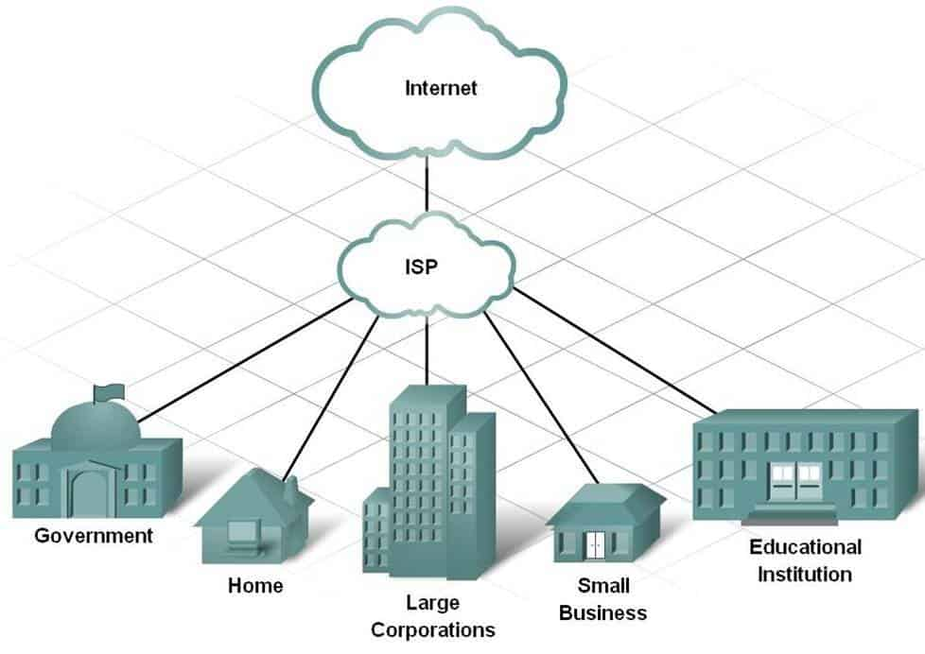
Hypertext:
hypertext is a system that provides a simple and consistent way to organize large data available on the Internet.
Internet Service Provider(ISP):

Slide 7
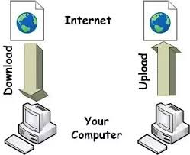
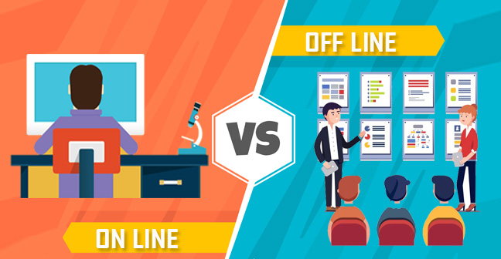
Web Server:
Download and Upload: Online and Offline

Slide 8
Getting connected to the internet
Basic requirements
The computer:
The computer must have at least 386-microprocessor chip with a minimum of 16
MB of RAM(128/256 MB).
Modem:
modem is a device which enables a computer to transmit data over telephone
lines. There are two types 1)Internal Modem 2)External Modem

Slide 9
Internet Connection:
Some of the connections available for the users these days are
Dial-up: A dial-up connection is the access method that uses telephone lines to connect to the Internet.
ISDN: It stands for Integrated Services Digital Network and is more common in business and commercial use.
Cable Modem: A cable modem connects the user to the Internet through a cable television line.
Leased Line: Usually leased lines facility can be provided through a fibre optic or copper lines.
DSL: Digital Subscriber Line service is provided through an existing telephone line but it works differently than regular analog modem dial-up access.
Broadband: This type of access is good for remote locations, where ISDN, cable, or DSL are not available.

Slide 10
Internet Applications
Electronic Mail(E-mail):
Electronic mail, or e-mail, is a fast, easy, and inexpensive way to communicate with other Internet users around the world.
File Transfer Protocol(FTP):
The FTP is set of rules that enables user to transfer files from one system to another.
3) Telnet:
The word “telnet” is derived from telecommunications and network.
4) Internet Relay Chat(IRC):
IRC is a service on the Internet that allows people to communicate in real time and carry on conversations via the computer with one or more people.

Slide 11
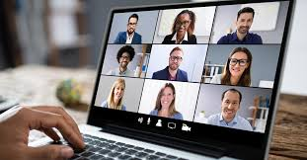
Chatting and Instant Messaging:
Chat programs allow users on the Internet to communicate with each other by typing in real time.
Internet Telephony:
Internet telephony is the use of the Internet rather than the traditional telephone component infrastructure, to exchange spoken or other telephonic information
Video Conferencing:
Video conferencing uses the same technology as IRC, but also provides sound and video pictures. It enables direct face-to-face communication across networks.
Notes:
Chatting has become one of the “killer applications” of Internet.

Slide 12
Commerce through Internet:
Now a day, various organizations offer the facility of shopping online. This type of business model is known as electronic commerce or E-commerce. E-commerce refers to buying and selling goods and services online.
Newsgroups(Usenet):
The newsgroups are International discussion groups that focus on a particular topic and helps in gathering information about that topic.
Mailing Lists(Listserver):
Mailing list is a method of Internet communication and it enables people with similar interests from all over the world to communicate and share information with each other.

Slide 13
Thank You

